Slide 1
WPF & CRUD operations
Week / Session 13
Namrata Aneja
ICT40518 Certificate IV in Programming
Data Driven Applications
ICTPRG431 | Apply Query Language
ICTPRG432 | Develop Data Driven Applications

Slide 2
Session Contents
Create, Browse
Read
Update
Delete
Insert
Clear

Slide 3
Requirements
WPF & Database 3

Slide 4
Requirements
You will require:
Windows 10 PC or Virtual Machine
Laragon with MySQL or MariaDB (preferred) running
Visual Studio Community 2019 (preferred)
Sample Database
This is in the presentation from Session 12

Slide 5
Setting up the CRUD Operations on Session 12 program by Making changes in the Previous session’s program, starting with Search button
WPF & Database 3

Slide 6
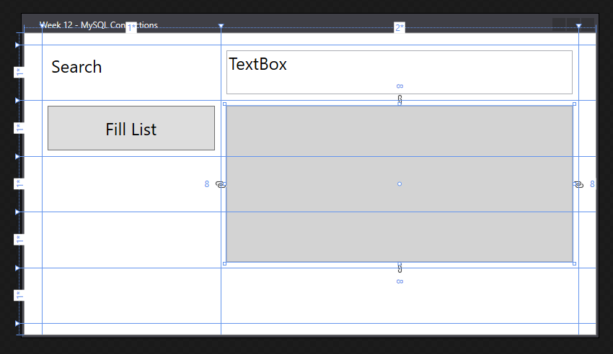
Created the GUI Layout in Session 12
We will be adding:
Grid column/rows
Labels
Textbox
Listbox
Button
Check Box
not shown

Slide 7
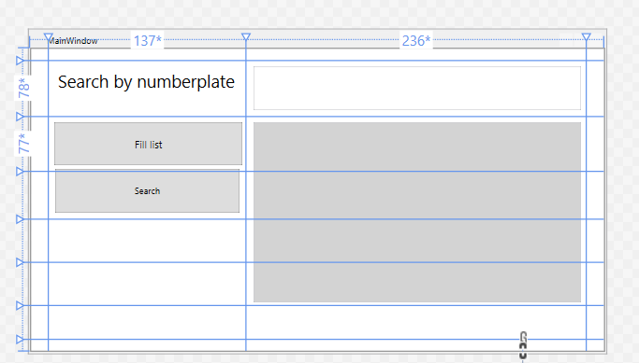
Adding search operation in the program
Pick the button from toolbox and place it in the XAML window. Change its Content to Search.Or You write code like this in the code area of xaml
<Button x:Name= "Searchrecord" Content="Search"
Grid.Column="1" HorizontalAlignment="Left"
Height="61" Margin="10,73.4,0,0"
Grid.Row="2"
Grid.RowSpan="2“
VerticalAlignment="Top"
Width="254" Click="Button_Click"/>
Give a name to the button as
Searchrecord.

Slide 8
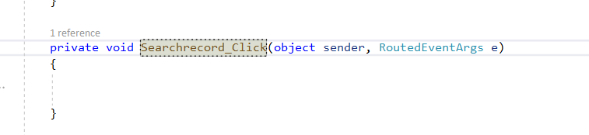
Adding search operation in the program
Double click on search button you will be led to MainWindow.xaml.cs

Slide 9
Adding search operation in the program
private void Searchrecord_Click(object sender, RoutedEventArgs e)
{
string sqlQuery = "Select * from traffic where number_plate like '%" + SearchTextbox.Text + "%';";
try
{
VehicleListbox.Items.Clear();
conn.Open();
MySqlCommand cmd = new MySqlCommand(sqlQuery, conn);
MySqlDataReader rdr = cmd.ExecuteReader();
while (rdr.Read())
{
VehicleListbox.Items.Add($"{rdr[1],5}: {rdr[2],5}kph: {rdr[3],5}:");
}
}
catch (Exception ex)
{
MessageBox.Show(ex.ToString());
}
conn.Close();
}
Notes:
Making changes in the sqlquery variable by using a search command with a like operator.
Searching the table traffic by number_plate. The command is
Select * from traffic where number_plate like '%" + SearchTextbox.Text + "%’;”;
SearchTextbox is the name of Textbox carrying data or number plate to be searched, the data in textbox is
represented by SearchTextbox.Text.

Slide 10
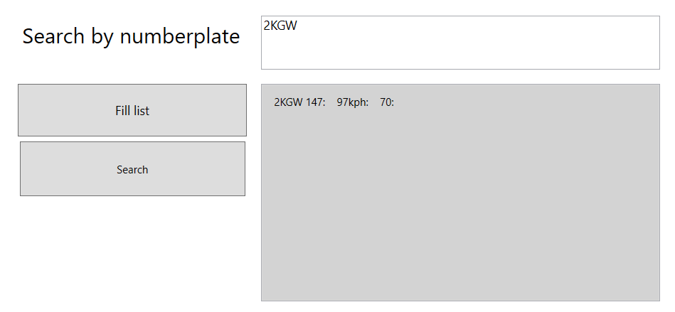
Writing number plate in search text box.You will get this kind of output
Notes:
By clicking search button after writing search data in search box you get related data record from the database.

Slide 11
Making changes in the session 12 program adding Search button or edit button
WPF & CRUD Operations

Slide 12
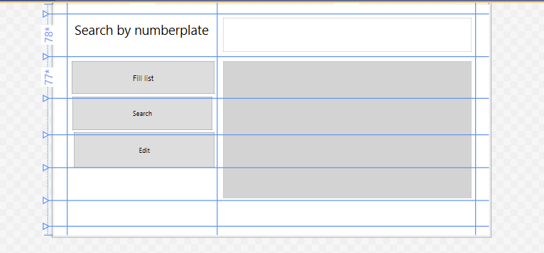
Add a button in the Mainwindow xaml code.
Change its Content to Edit in the XAML codes.
Give it a name =Editrecord.
<Button x:Name="Editrecord" Content="Edit" Grid.Column="1" HorizontalAlignment="Left" Margin="12,61.6,0,0" Grid.Row="3" VerticalAlignment="Top" Width="256" Height="65" Click="Editrecord_Click" Grid.RowSpan="3"/>
Double click on the Edit button

Slide 13
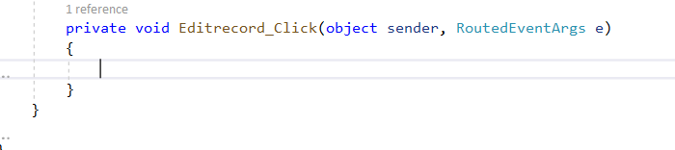
You will end up at Mainwindow.xaml.cs
Write the given code within the curly brackets for updation here by changing the query with the update and set command.

Slide 14
Adding Update command
string sqlQuery = "Update traffic set speed=90, speed_limit=60 where number_plate like '%" + SearchTextbox.Text + "%';";
try
{
VehicleListbox.Items.Clear();
conn.Open();
MySqlCommand cmd = new MySqlCommand(sqlQuery, conn);
cmd.ExecuteNonQuery();
}
catch (Exception ex)
{
MessageBox.Show(ex.ToString());
}
conn.Close();
Based on the Number plate the record is edited with the speed of 90 and speed limit 60 Here,We do not require sql reader therefore we are using a Method called
ExecuteNonQuery (); This is a sql function that is called here.
Creating an object cmd and calling ExecuteNonQuery ();
This will change the data in the table traffic.

Slide 15
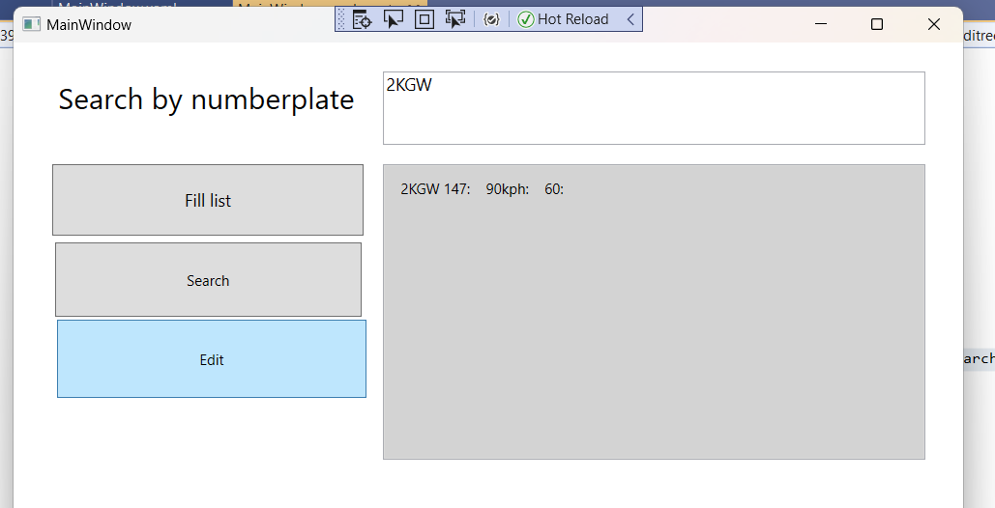
The Output will be
The values are edited according to the command

Slide 16
Making changes in the session 12 program adding Delete button
WPF & CRUD Operations

Slide 17
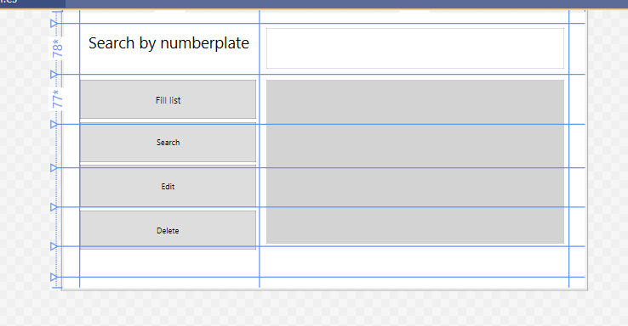
Add a delete button
Make the following changes in XAML codes
<Button x:Name="Deleterecord" Content="Delete" Grid.Column="1" HorizontalAlignment="Left" Margin="0,5.2,0,0" Grid.Row="5" VerticalAlignment="Top" Width="268" Height="59" Click="Deleterecord_Click" Grid.RowSpan="2"/>

Slide 18
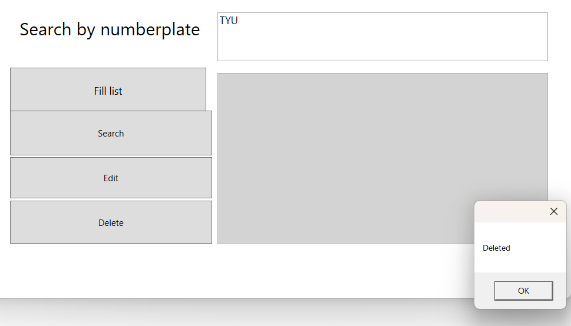
Add the given code with the delete query
private void Deleterecord_Click(object sender, RoutedEventArgs e)
{
string sqlQuery = "Delete from traffic where number_plate like '%" + SearchTextbox.Text + "%';";
try
{
VehicleListbox.Items.Clear();
conn.Open();
MySqlCommand cmd = new MySqlCommand(sqlQuery, conn);
MySqlDataReader rdr = cmd.ExecuteReader();
while (rdr.Read())
{
VehicleListbox.Items.Add($"{rdr[1]}: {rdr[2],5}kph");
}
MessageBox.Show("Deleted");
}
catch (Exception ex)
{
MessageBox.Show(ex.ToString());
}
conn.Close();
}
And after executing the delete button the record with the given number plate is deleted .

Slide 19
Making changes in the session 12 program adding INsert button
WPF & CRUD Operations

Slide 20
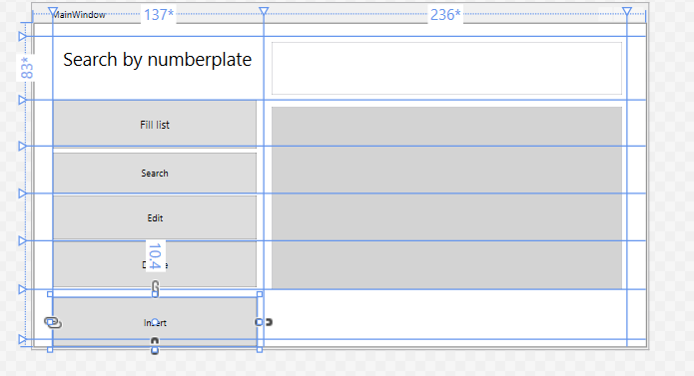
Add another button
Change the content to Insert for this button

Slide 21
Write the given code under the Insert button
private void Button_Click_1(object sender, RoutedEventArgs e)
{
insertwindow op1 = new insertwindow();
op1.ShowDialog();
}
This code will connect the Main Window with insert window

Slide 22
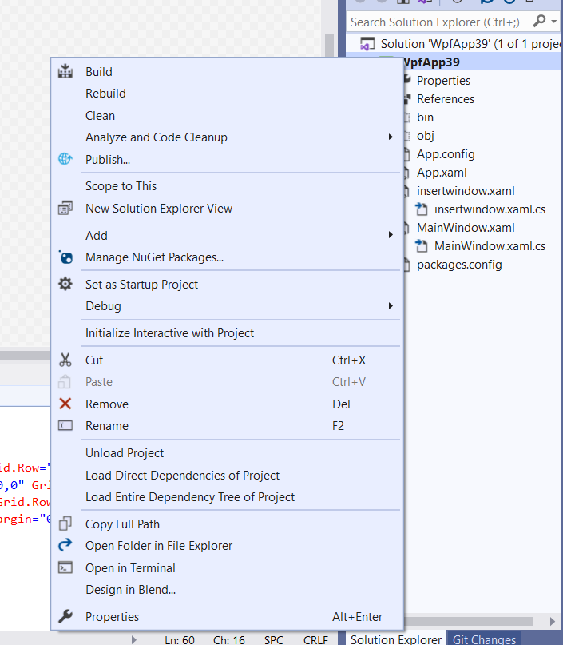
Insert button
Place your cursor on the name of the project in solution explorer and right click

Slide 23
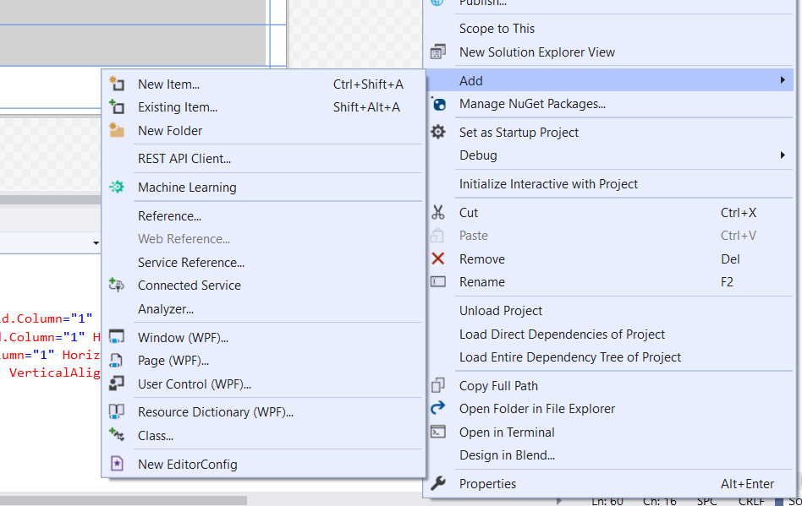

Connect to another window
Click on Add button and a drop down menu will appear.
If we click on New Item another menu will show up

Slide 24
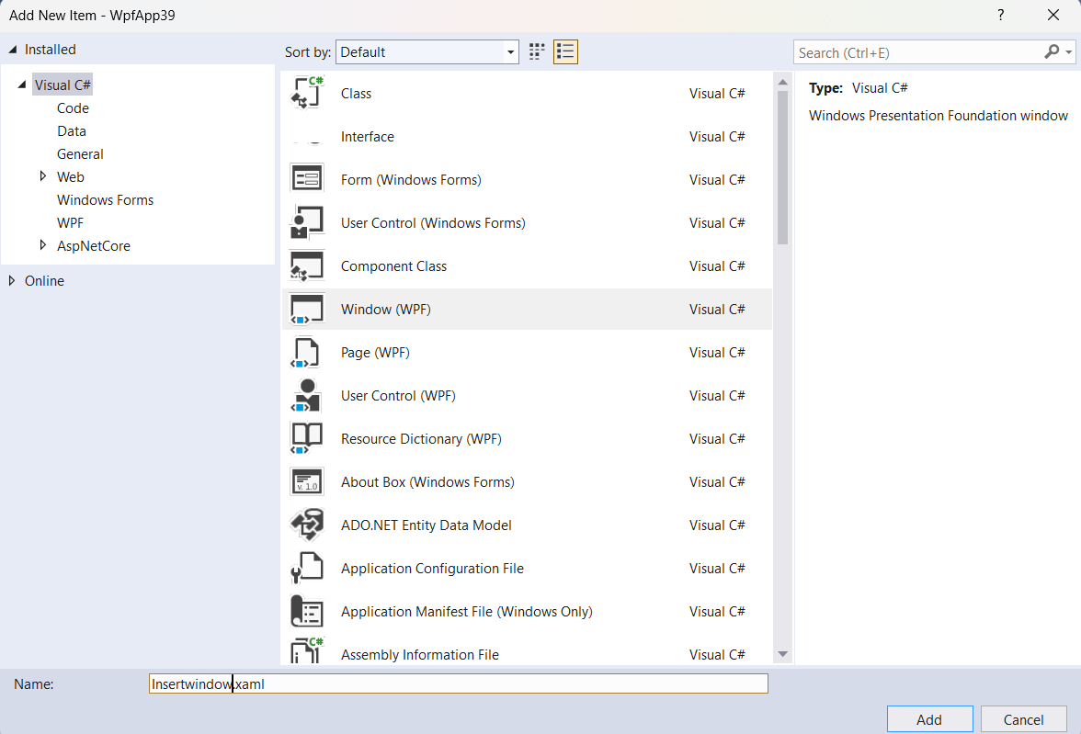

Adding another wpf to the project
Select windows wpf from here.
Give it a name. Here the name in the screenshot is Insertwindow.xaml
And click on Add button.
By doing so another connecting window will be connected with the Main window.

Slide 25
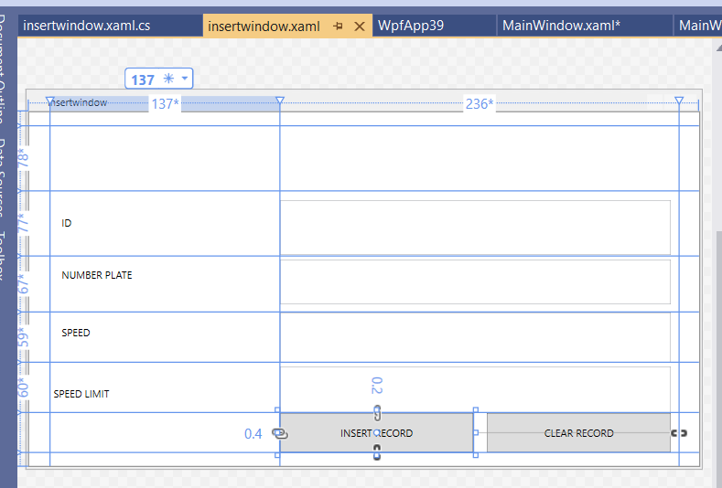
Insert windows xaml file
This additional Window is just like any other XAML file.
We have added few Labels , Text boxes and Insert and Clear button from the tool box using the same Grid- Row and Column combination of Main Window. Xaml file.

Slide 26
The Xaml Code written between the Grid is like this
<Grid>
<Grid.ColumnDefinitions>
<ColumnDefinition Width="24"/>
<ColumnDefinition Width="1*"/>
<ColumnDefinition Width="2*"/>
<ColumnDefinition Width="24"/>
</Grid.ColumnDefinitions>
<Grid.RowDefinitions>
<RowDefinition Height="16"/>
<RowDefinition Height=“1*"/>
<RowDefinition Height=“1*"/>
<RowDefinition Height=“1*"/>
<RowDefinition Height=“1*"/>
<RowDefinition Height=“1*"/>
<RowDefinition Height=“1*"/>
<RowDefinition Height="16"/>
</Grid.RowDefinitions>
<Label Content="ID" Grid.Column="1" HorizontalAlignment="Left" Margin="10,24.4,0,0" Grid.Row="2" VerticalAlignment="Top" Width="254"/>
<Label Content="NUMBER PLATE" Grid.Column="1" HorizontalAlignment="Left" Margin="10,9.6,0,0" Grid.Row="3" VerticalAlignment="Top" Width="248"/>
<Label Content="SPEED" Grid.Column="1" HorizontalAlignment="Left" Margin="10,10.4,0,0" Grid.Row="4" VerticalAlignment="Top" Width="254"/>
<Label Content="SPEED LIMIT" Grid.Column="1" HorizontalAlignment="Left" Margin="0,24.2,0,0" Grid.Row="5" VerticalAlignment="Top" Width="264"/>

Slide 27
The Xaml Code written between the Grid is like this
<TextBox x:Name="IdText" HorizontalAlignment="Left" Height="66" Margin="0.4,10.4,0,0" TextWrapping="Wrap" Text="" VerticalAlignment="Top" Width="462" RenderTransformOrigin="0.852,2.951" Grid.Column="2" Grid.Row="2"/>
<TextBox x:Name="NpText" HorizontalAlignment="Left" Height="53" Margin="0.4,4.6,0,0" TextWrapping="Wrap" Text="" VerticalAlignment="Top"
Width="462" RenderTransformOrigin="0.852,2.951" Grid.Column="2" Grid.Row="3"/>
<TextBox x:Name="SpText" HorizontalAlignment="Left" Height="59" Margin="0.4,0.4,0,0" TextWrapping="Wrap" Text="" VerticalAlignment="Top" Width="462" RenderTransformOrigin="0.852,2.951" Grid.Column="2" Grid.Row="4" Grid.RowSpan="2"/>
<TextBox x:Name="SlText" HorizontalAlignment="Left" Height="55" Margin="0.4,5.2,0,0" TextWrapping="Wrap" Text="" VerticalAlignment="Top" Width="462" RenderTransformOrigin="0.852,2.951" Grid.Column="2" Grid.Row="5" Grid.RowSpan="2"/>

Slide 28
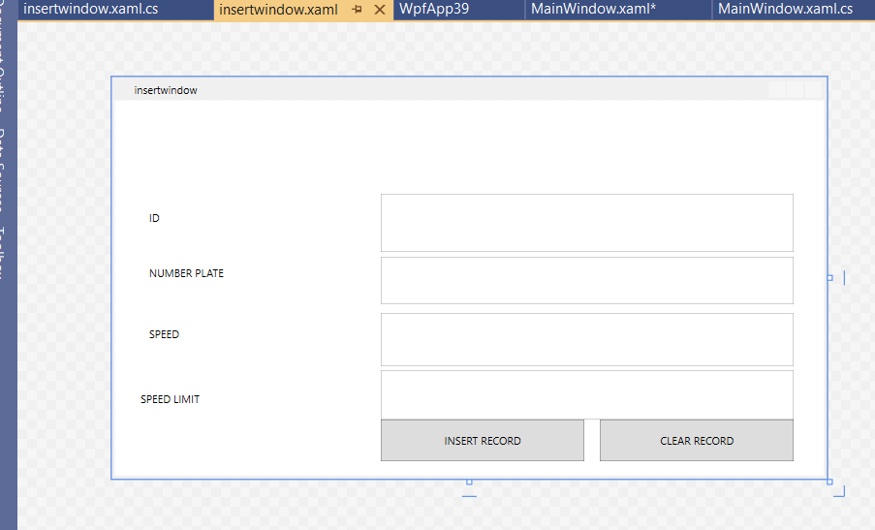
The screen will look like this
<Button x:Name="InsertButton" Content="INSERT RECORD" Grid.Column="2" HorizontalAlignment="Left" Margin="0.4,0.2,0,0" Grid.Row="6" VerticalAlignment="Top" Width="228" Height="47" Click="InsertButton_Click"/>
<Button x:Name="ClearButton" Content="CLEAR RECORD" Grid.Column="2" HorizontalAlignment="Left" Margin="244.4,0.2,0,0" Grid.Row="6" VerticalAlignment="Top" Width="218" Height="47" Click="ClearButton_Click"/>
</Grid>

Slide 29
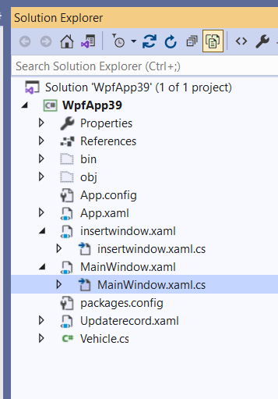

Go to Insertwindow.xaml
.Click on the triangle with insertwindow.xamlYou will find a csharp file with same name but with the .cs extension
insertwindow.xaml.cs

Slide 30
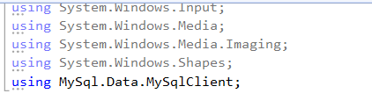
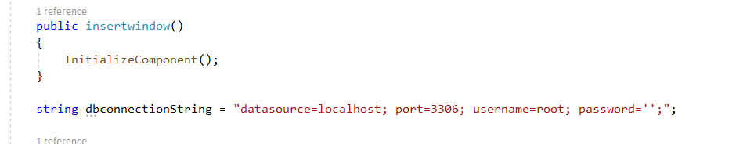
Go to Insertwindow.xaml.cs and write the following
In the Library functions
Write these words
.Using MySql.Data.MySqlClient;
This will connect C# with Mysql module .
Also write database string . connection with the username and password and other required datasource and port

Slide 31
Write the Methods for Insert record and Clear
public void insertrec()
{
MySqlConnection conn = new MySqlConnection(dbconnectionString);
string sqlQuery = "Insert into xxx_traffic_cop.traffic values ('" + this.IdText.Text + "','" + this.NpText.Text + "','" + this.SpText.Text + "','" + this.SlText.Text + "')";
MySqlCommand cmd = new MySqlCommand(sqlQuery, conn);
try
{ conn.Open();
MySqlCommand cmd1 = new MySqlCommand(sqlQuery, conn);
cmd1.ExecuteNonQuery();
MessageBox.Show("Added");
conn.Close();
}
catch (Exception ex)
{
MessageBox.Show(ex.ToString());
}
conn.Close();
}

Slide 32
Under these button clicks call the related methods
public void cleardata()
{
IdText.Clear();
NpText.Clear();
SpText.Clear();
SlText.Clear();
}
private void InsertButton_Click(object sender, RoutedEventArgs e)
{
insertrec();
}
}
private void ClearButton_Click(object sender, RoutedEventArgs e)
{
cleardata();
}

Slide 33
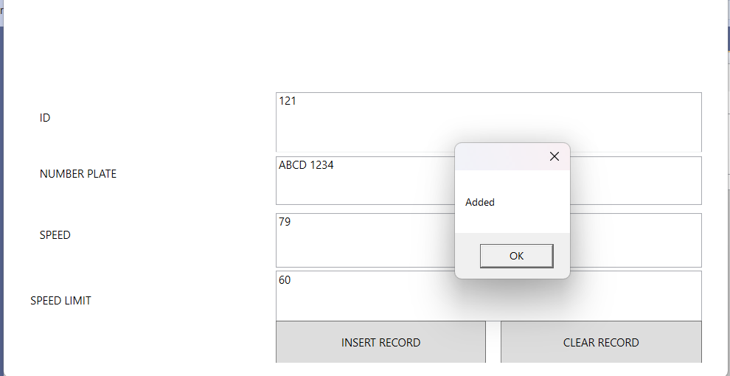
Inserting the data record
After entering the data in the text boxes, Hit the Insert button and the data record is added to the data base

Slide 34
Making changes in the session 12 program adding Clear button
WPF & CRUD Operations

Slide 35
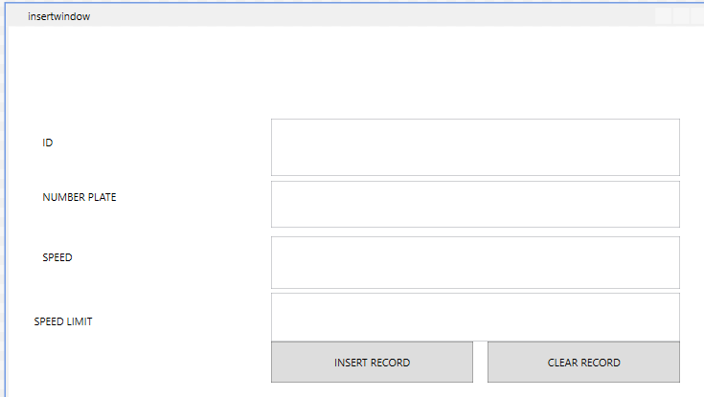
Clear Button
Write the following code under clear button in the xaml.cs file.
public void cleardata()
{
IdText.Clear();
NpText.Clear();
SpText.Clear();
SlText.Clear();
}
IdText, NpText, SpText, SlText are the names of textboxes.
After hitting the clear button screen will be like this

Slide 36
End of CRUD operations

Slide 37
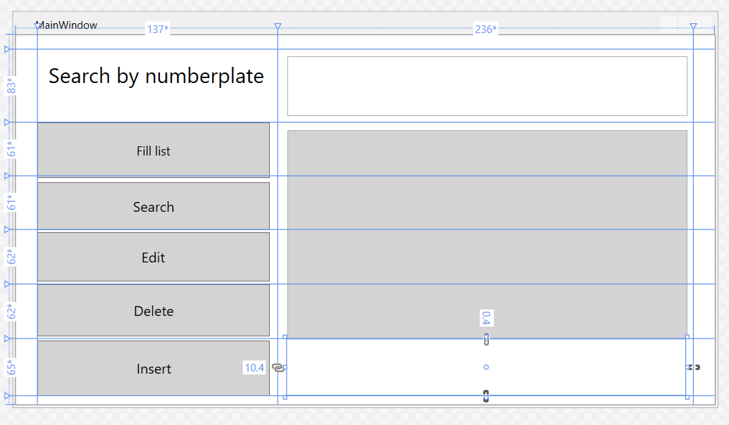
Add a picture
To add a picture in row 6
Write the given command in the Xaml file
<Image Grid.Column="2" HorizontalAlignment="Left" Height="64" Margin="10.4,0.4,0,0" Grid.Row="6" VerticalAlignment="Top" Width="452" />

Slide 38
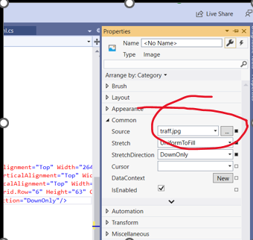
Add a picture
Go to Google
Find an image
Download image as jpeg file.
Go to Properties of Image and click at … you will end up into this screen

Slide 39
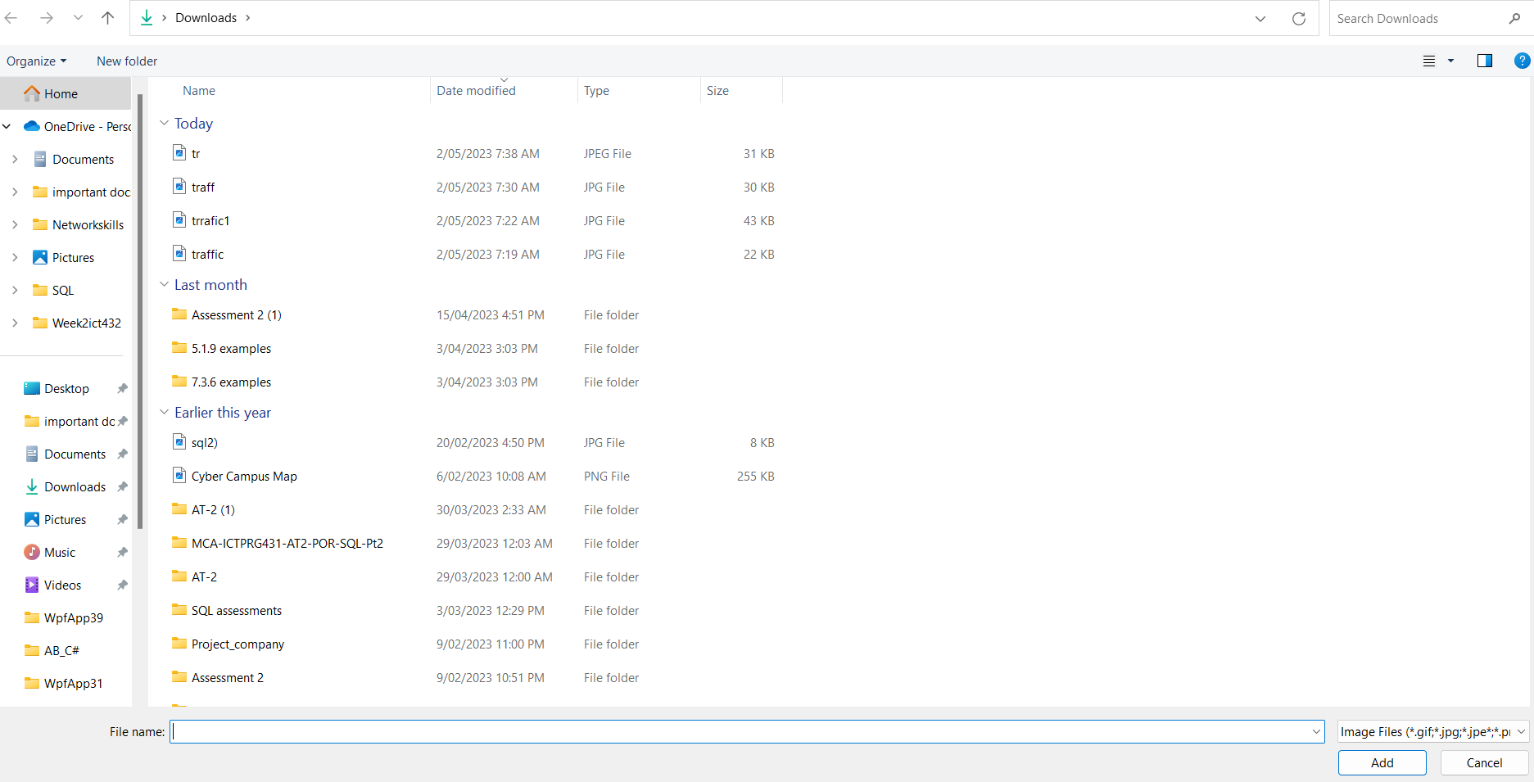
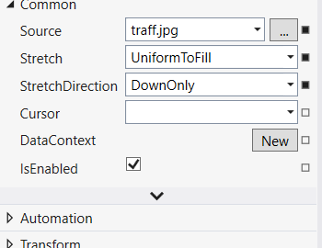

Add a picture
Select a the downloaded file
Add it
You can also make changes in
Stretch and its direction

Slide 40
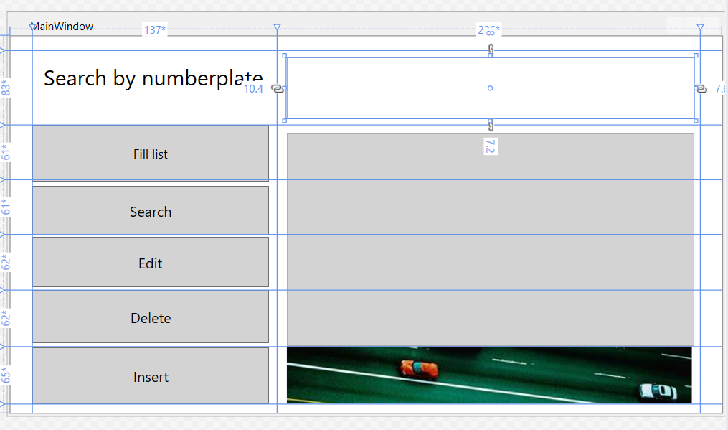
Add a picture
You will end up into similar screen or you can make changes in the command
<Image Grid.Column="2" HorizontalAlignment="Left" Height="64" Margin="10.4,0.4,0,0" Grid.Row="6" VerticalAlignment="Top" Width="452" Source="traff.jpg" Stretch="UniformToFill" StretchDirection="DownOnly"/>

Slide 41
Exercise
Add a WPF window for table Demerits and addsearch textbox,listbox,insert, delete and search buttons and their functions.
Add colour, Font, Picture and back ground colour into the
Demerits file WPF.

